Slide 1
Pandonia Global Network (PGN)
Status & Plans - From NASA Perspective
Presentation to 5th TOLNet / 2018 NDACC LWG Meeting
R. Swap¹, A. Cede^{2,3}, N. Abuhassan⁴, M. Tiefengraber², L. Shalaby⁴, J. Robinson⁴, D. Santana³, M. Mueller³, C. Posch³, A. Kreuter³, M. Grunberg⁵,
A. Dimov⁶, J. Herman⁴ and E. Spinei⁷
University of Alabama in Huntsville, Huntsville, AL, May 7-11, 2018
¹ NASA GSFC (614); ²Luftblick; ³GESTAR; ⁴JCET; ⁵ESSIC; ⁶SSAI; ⁷Virginia Tech
robert.j.swap@nasa.gov
Notes:
DIRECTED FUNDING!!!

Slide 2
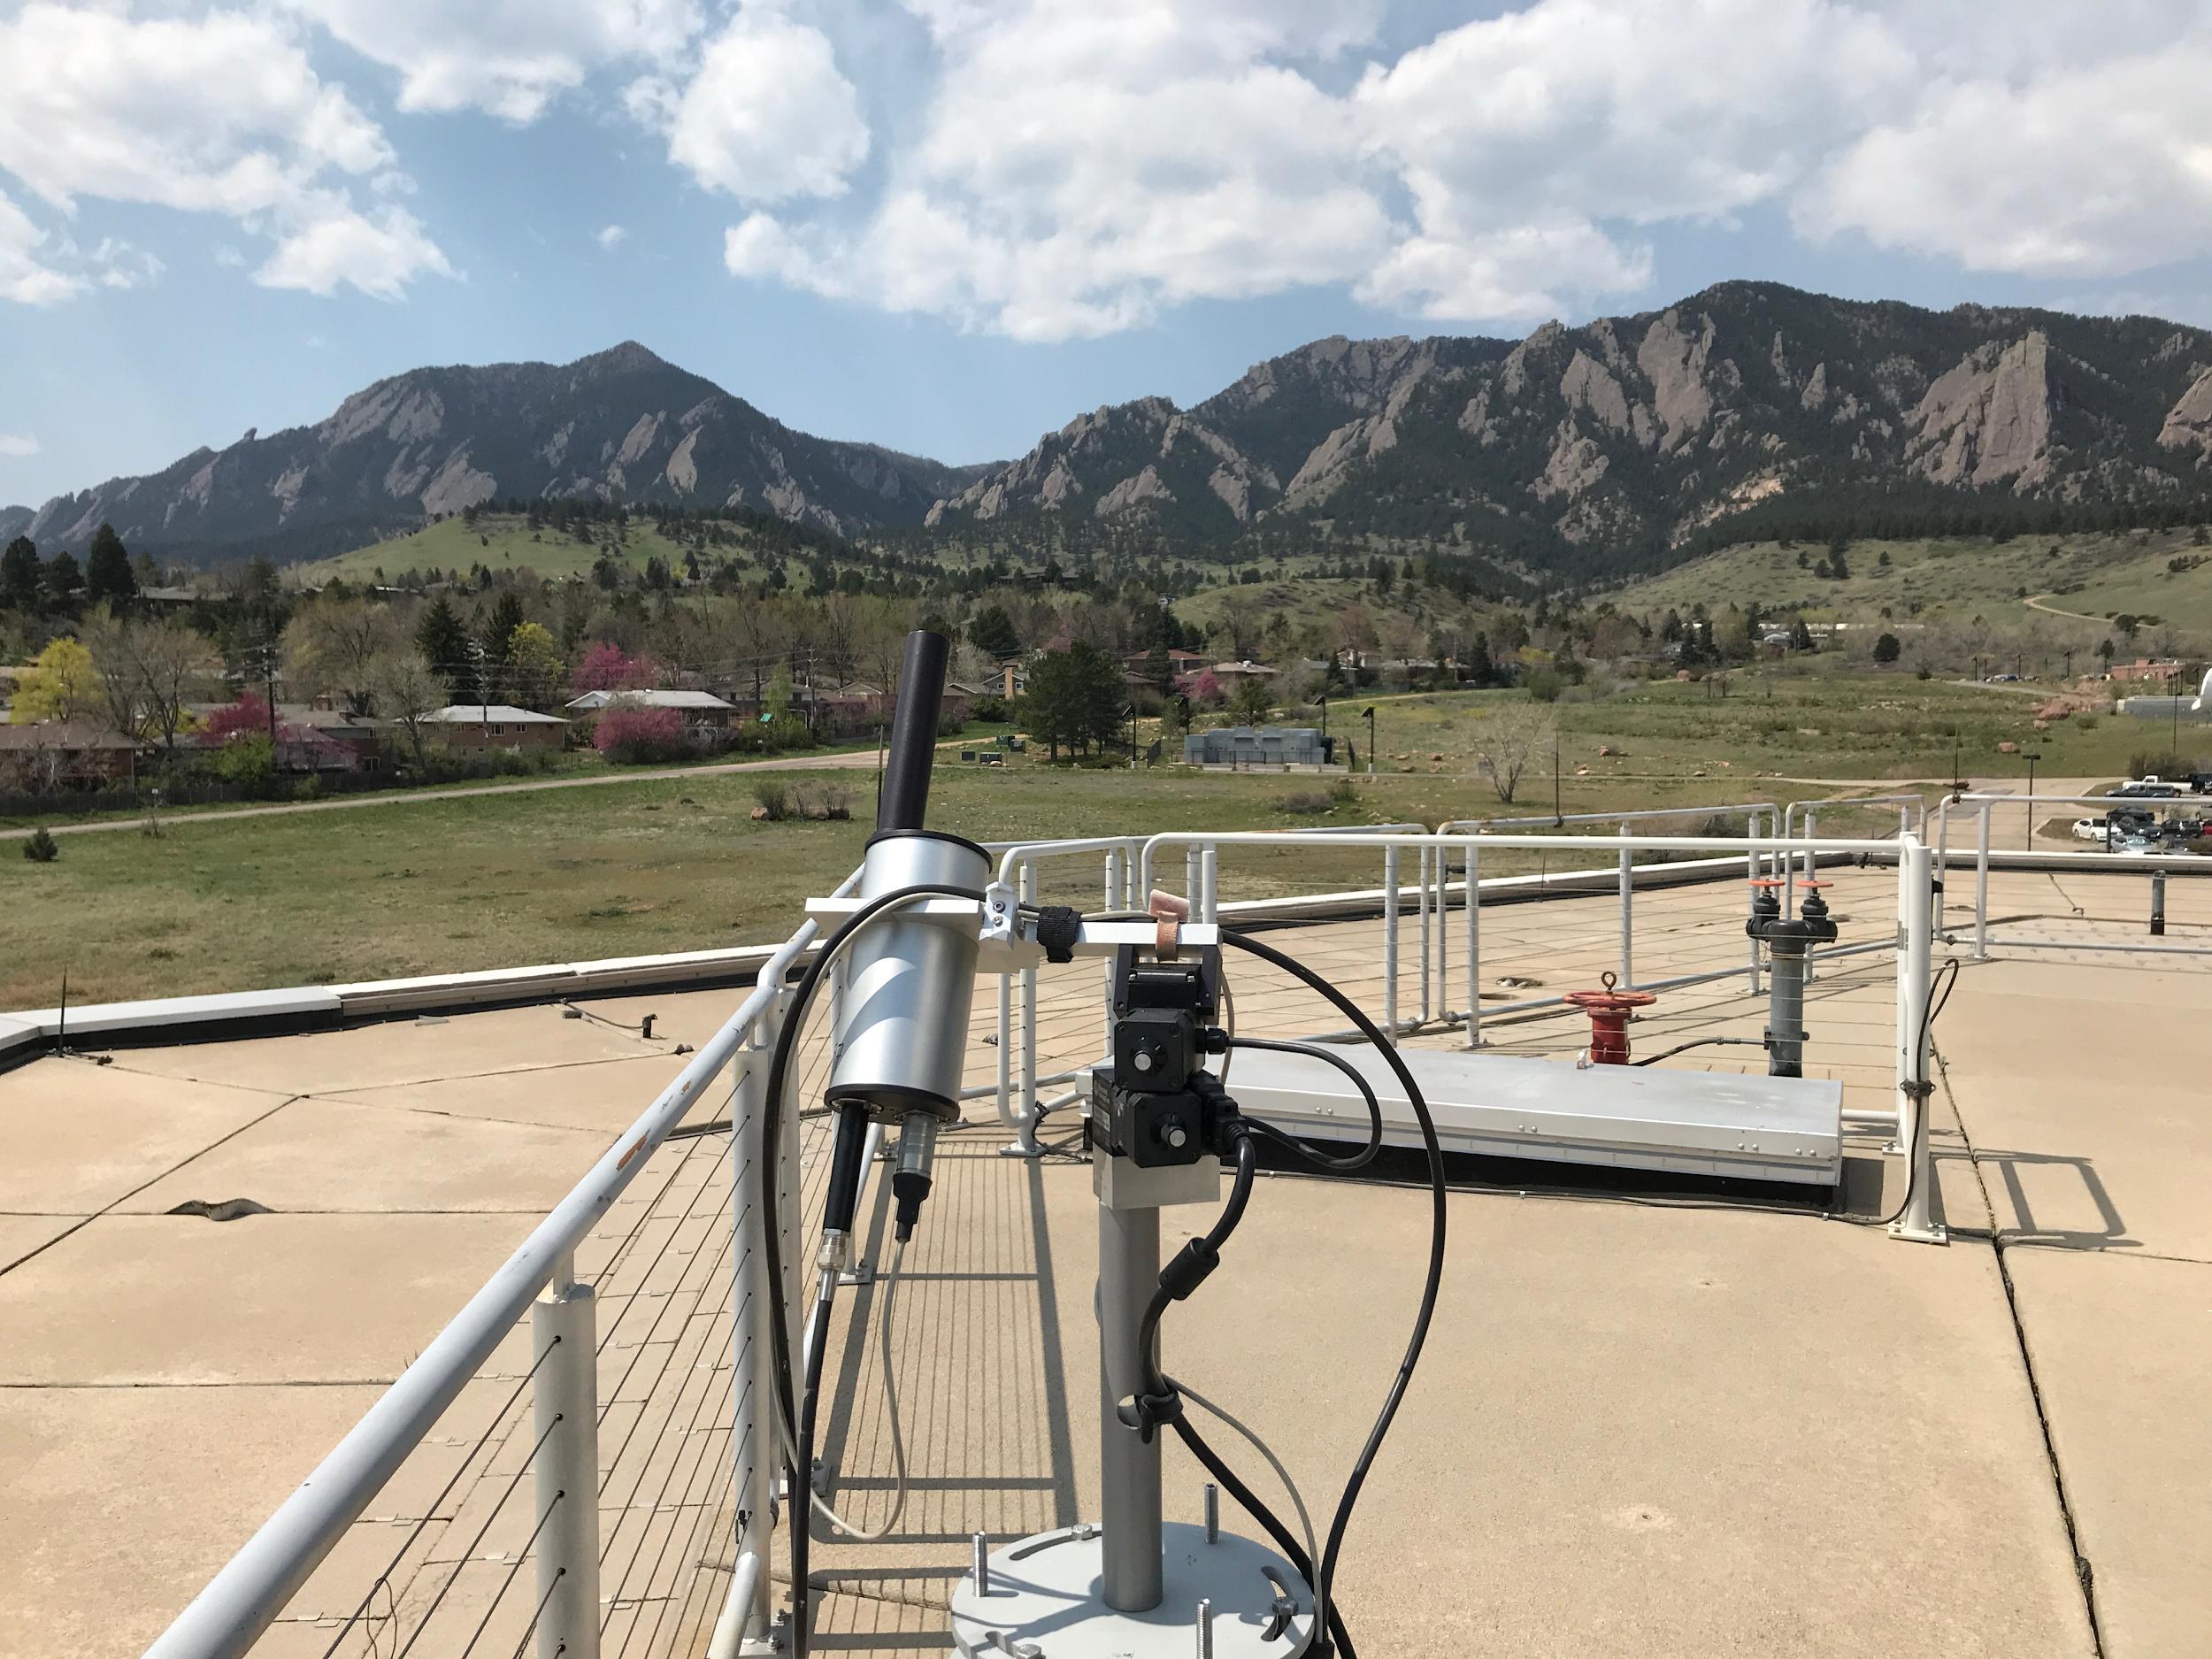
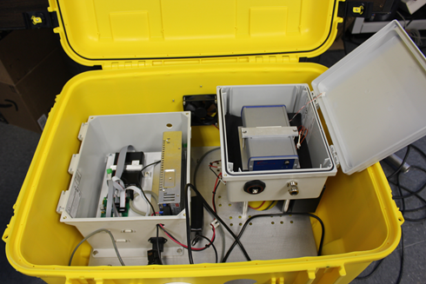
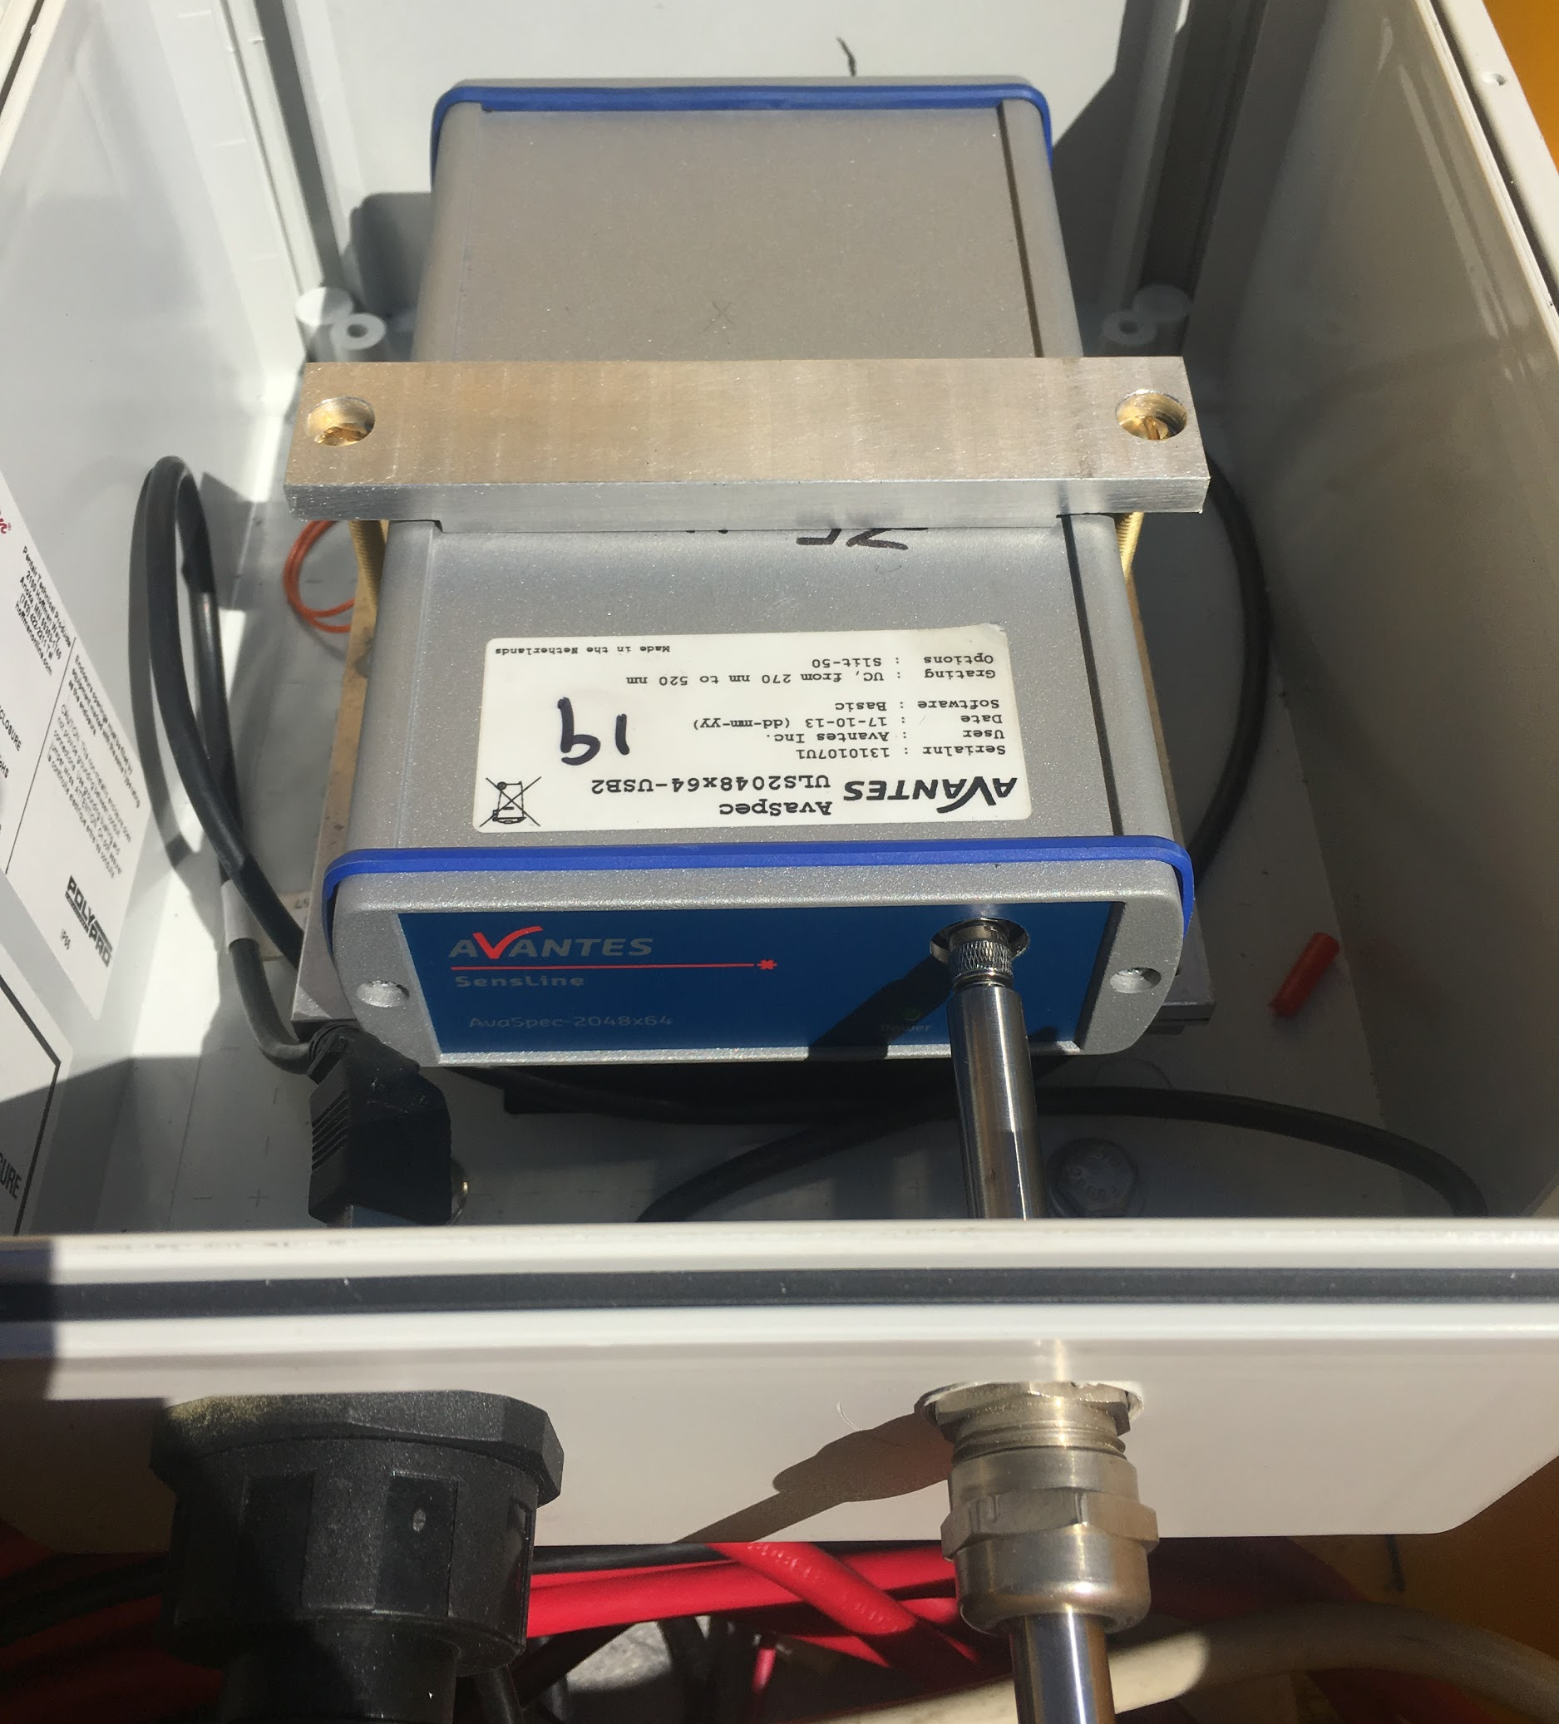
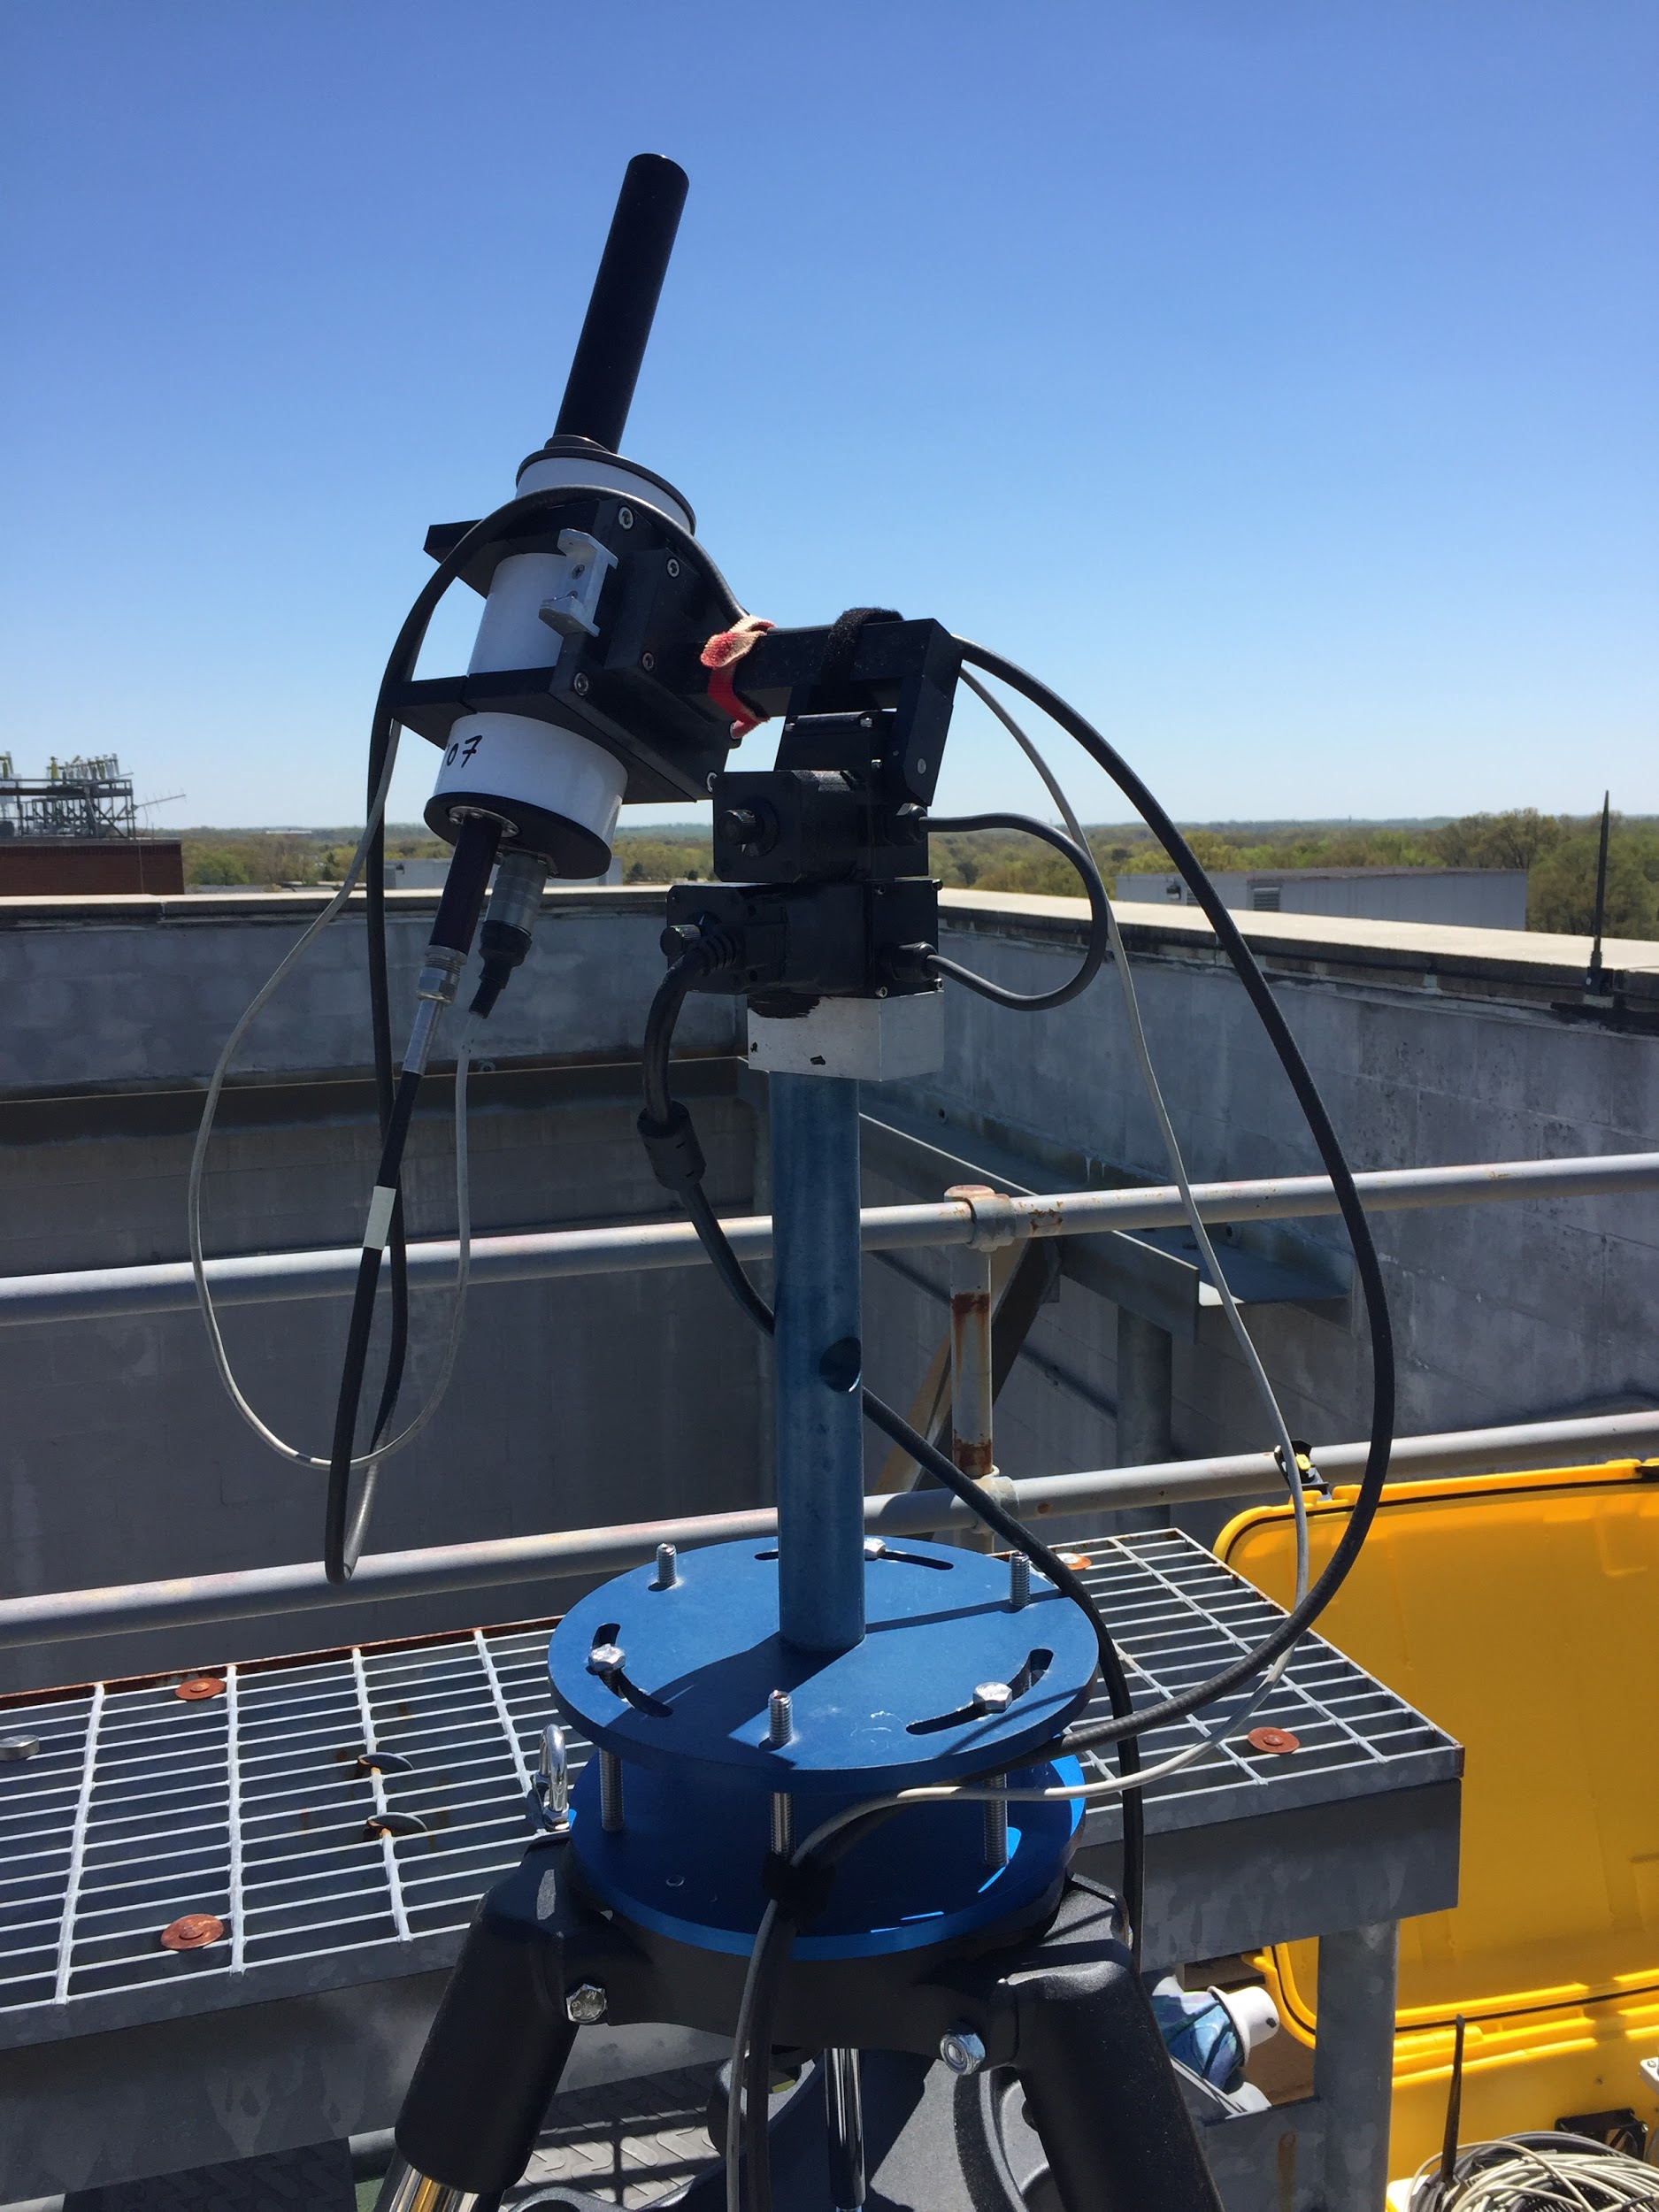
What is the Pandora Spectrometer System?
Small, ground-based Sun/Sky/Lunar observing spectrometer system initiated in 2006 at NASA Goddard Space Flight Center
- (Pandora 1S - 270 – 530 nm, 0.6 nm; 2S – 400 – 900 nm, 1 nm)
NRT Standard Products at high frequency (~ 2 mins)
- Tot. Column O3 (+/-15 DU, ~5%); Tot. Column NO2 (+/-0.05 DU, ~10%)
Additional non-validated products
- HCHO - Total column, trop. & near sfc; NO2, O3 – trop. & near sfc
Operates autonomously off of line power and wifi; software runs on a small PC found inside the weather resistant container.
Boulder, CO
Pandora Field Box
Spectrometer
Sensor Head

Slide 3
Instrument Specifications*
Elevation (zenith) Range: 0° to 270°
Azimuth Range: 360°
Set Temperature Range: -20°-40°C; calibrated at 15° and 20°C
Field of View: 1.5°
Spectral Range: 270 - 530nm
Spectral Resolution: 0.6nm
Power: 120/220VAC
Internet connectivity (Wifi/Wired)
Filter wheel 2:
“Functional” filters
(U340, BP300, DIFF)
Entrance window
(anti reflection coating)
Optical fiber
(400 μm, multi-mode single core fused silica)
Lense (plano convex)
Filter wheel 1: Attenuation filters (ND1, ND2, ...)
*Configuration of a standard Pandora 1S

Slide 4
What is the Pandonia Global Network (PGN)?
Ground-based network - a joint NASA/ESA collaborative effort modeled in the spirit of other networks (e.g. AERONET)
From 2017 onwards, focus primarily on operationalization
Objective: to expand and coordinate a global network of standardized, calibrated instruments and systematically process and disseminate the data to the greater global community in support of in-situ and remotely sensed air quality monitoring

Slide 5
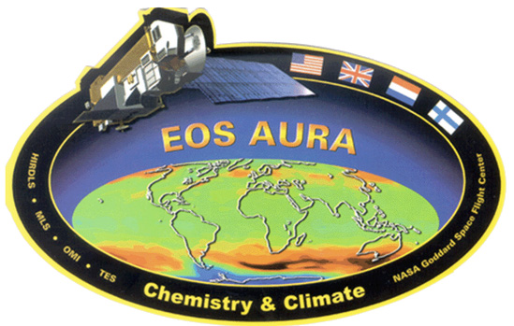
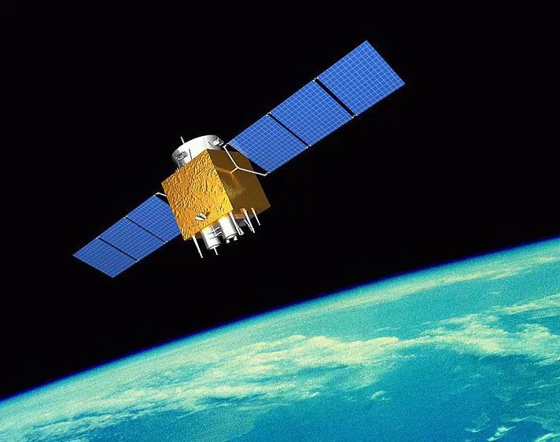
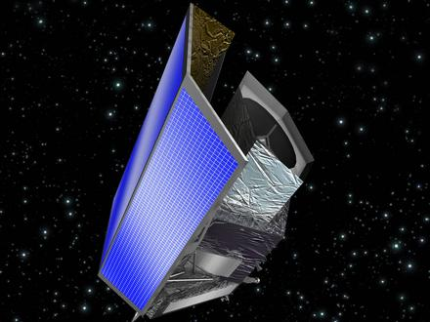
Why is it important?
Support of ESD Science and Satellite Validation/Verification

Slide 6
Current and Future AQ/AC Satellite Missions
Mission | Agency | Launch | Instrument(s) | Synergistic Pandora Observations | Orbit
AURA | NASA | 2004 | OMI | O3, NO2, SO2, HCHO, BrO | LEO
MetOp-A | EUMETSAT | 2006 | GOME-2 | O3, NO2, SO2, HCHO, BrO | LEO
S-NPP | NASA | 2011 | OMPS | O3, SO2 | LEO
MetOp-B | EUMETSAT | 2012 | GOME-2 | O3, NO2, SO2, HCHO, BrO | LEO
DSCOVR | NASA | 2015 | EPIC | O3, SO2 | L1
Sentinel 3A | EUMETSAT | 2016 | MWR, OLCIS, LSTR | H2O | LEO
Sentinel 5P | ESA | 2017 | TROPOMI | O3, NO2, SO2, HCHO | LEO
Sentinel 3B | EUMETSAT | 2018 | MWR, OLCIS, LSTR | H2O | LEO
GaoFen-5 | CSA | 2018 | EMI | O3, NO2, SO2, HCHO | LEO
GEO-KOMPSAT 2 | KMA | 2019 | GEMS | O3, NO2, SO2, HCHO, CHOCHO | GEO
TEMPO | NASA | 2019 | TEMPO | O3, NO2, SO2, HCHO, CHOCHO | GEO
Sentinel 4 | EUMETSAT | 2021 | UVN | O3, NO2, SO2, HCHO | GEO
Senintel 5 | EUMETSAT | 2021 | UVNS | O3, NO2, SO2, HCHO | LEO
MAIA | NASA | TBD | MAIA | SO2, NO2 (aerosol precursors) | LEO

Slide 7
Pandonia Global Network (PGN)
Shared Responsibilities
Network Operations
Calibration, QA/QC
Training of Local Operators
Field Campaigns
Science
NASA Pandora
Responsibilities:
NASA Instrument Builds
Calibration/deployment
maintenance
Network Operations
Data Mirroring
Managed by: NASA GSFC
ESA Pandonia
Responsibilities:
Software Development
Calibration
Network Operations
Central Processing
Data Serving
Managed by: Luftblick

Slide 8
NASA/ESA/PGN Accomplishments for past year
STANDARDIZATION and CONVERGENCE:
Summer Intern Training by ESA-Pandonia for NASA GSFC (July ‘17)
NASA/ESA instrument deployment / local operations training (Oct ‘17)
Maturing remote monitoring/support of operations:
instruments, local operators and scientists (Oct-Dec ‘17)
Week-long ESA/NASA PGN Workshop - focus on manual development / harmonization of calibration procedures/data processing / Global Network development (Dec ‘17)
Quick Start Guide for Instrument Set up, local operations and troubleshooting (started in Oct 17’ - ongoing)

Slide 9
NASA/ESA/PGN Accomplishments for past year cont.
Production of scientific manuscripts
Spinei, E. et al. The First Evaluation of Formaldehyde Column Observations by Pandora Spectrometers during the KORUS-AQ Field Study, Atmos. Meas. Tech. Discuss., https://doi.org/10.5194/amt-2018-57 , in review, 2018.
Herman, J. et al.: NO2 and HCHO measurements in Korea from 2012 to 2016 from Pandora Spectrometer Instruments compared with OMI retrievals and with aircraft measurements during the KORUS-AQ campaign, Atmos. Meas. Tech. Discuss., https://doi.org/10.5194/amt-2018-56 , in review, 2018.
Jeong, U et al. (2018). Langley calibration analysis of solar spectroradiometric measurements: Spectral aerosol optical thickness retrievals. Journal of Geophysical Research: Atmospheres, 123. https://doi.org/10.1002/2017JD028262 .
Sullivan, J. T. et al. The Ozone Water-Land Environmental Transition Study (OWLETS): A Unique Strategy for Understanding Pollution Events within the Chesapeake Bay. Submitted to Bulletin of the American Meteorological Society, March 2018.
Judd, L. et al. (2018). The Dawn of Geostationary Air Quality Monitoring: Case Studies from Seoul and Los Angeles. Submitted to Frontiers in Environmental Science
Gronoff, G. et al. A Method for Observing Near Range Point Source Induced O3 Titration Events Using Co-located Lidar and Pandora measurements. Atmospheric Measurement Techniques. Submitted April 2018
Engaging with international agencies (e.g. EUMESAT, KIER, ESA, ECCC)
Exposure and training of cohorts of interns (2017 and 2018)

Slide 10
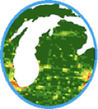
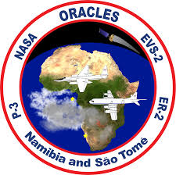
Recent NASA/ESA/PGN supported Field Campaigns
Notes:
Images
Layout of OWLETS field campaign, SARP-E involvement, SERC
Inter-conversion/Titration Event w/ schematic, plots, etc

Slide 11
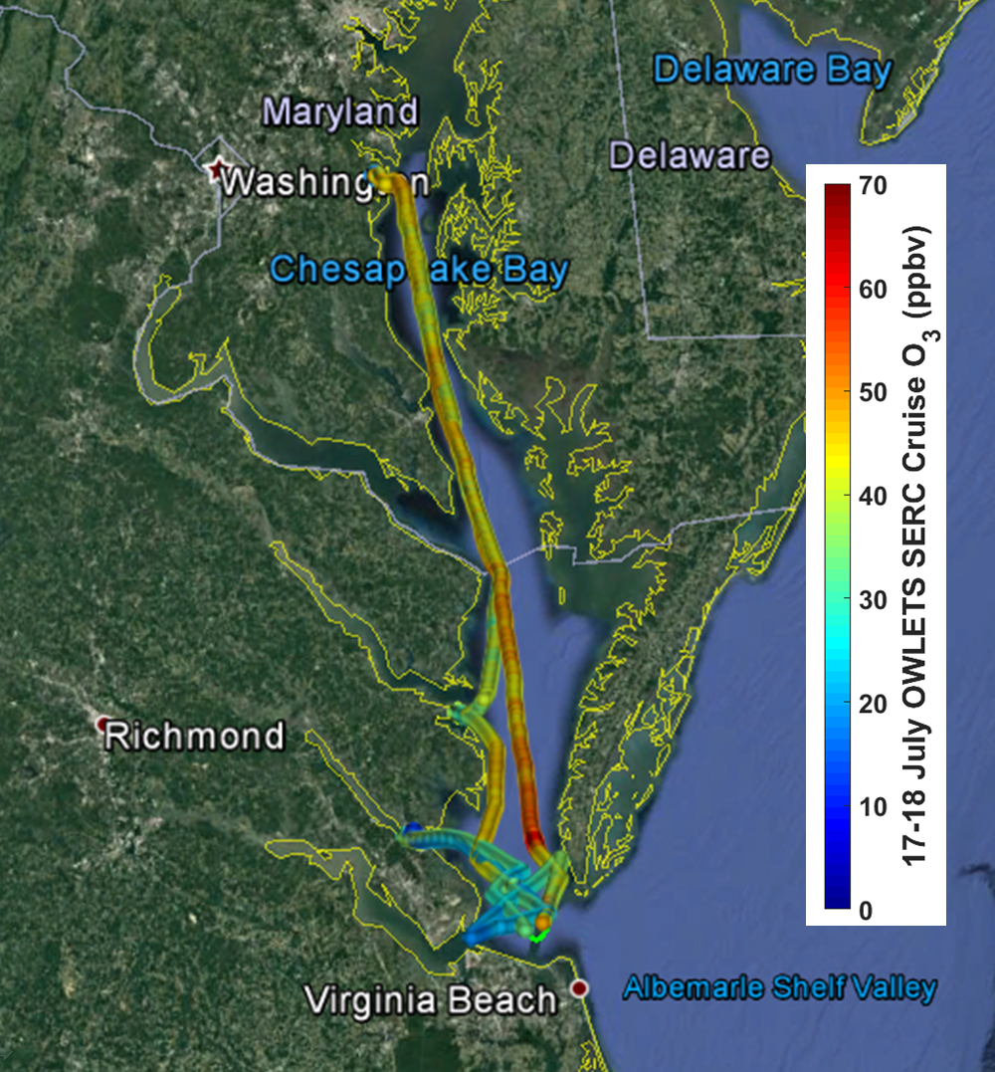
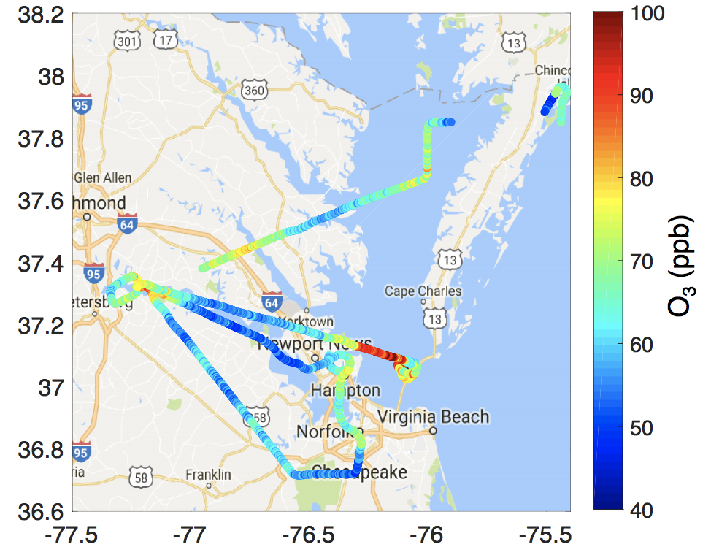
OWLETS Overview
SERC RV
NASA C-23 Sherpa
07/17 & 07/18 in-situ Ozone
07/20 Ozone (≤ 500 m ASL)

Slide 12
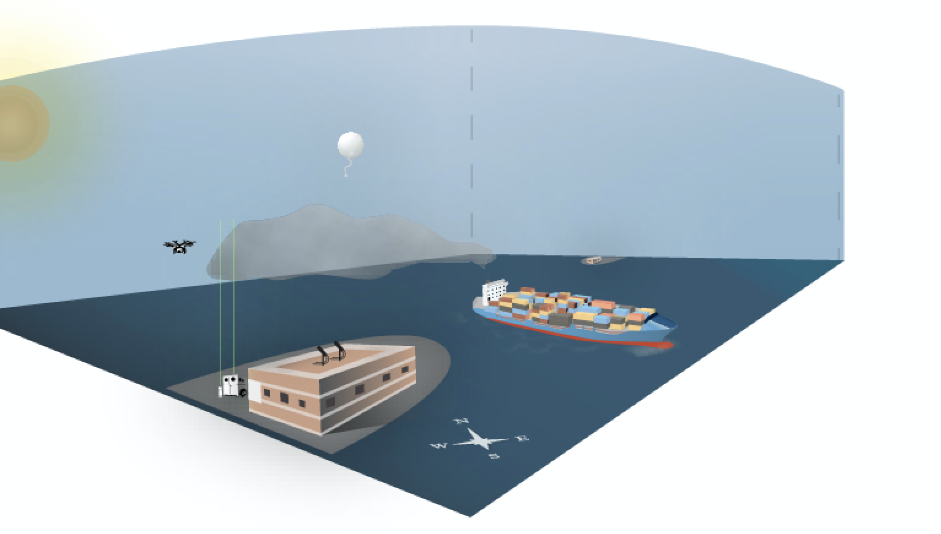
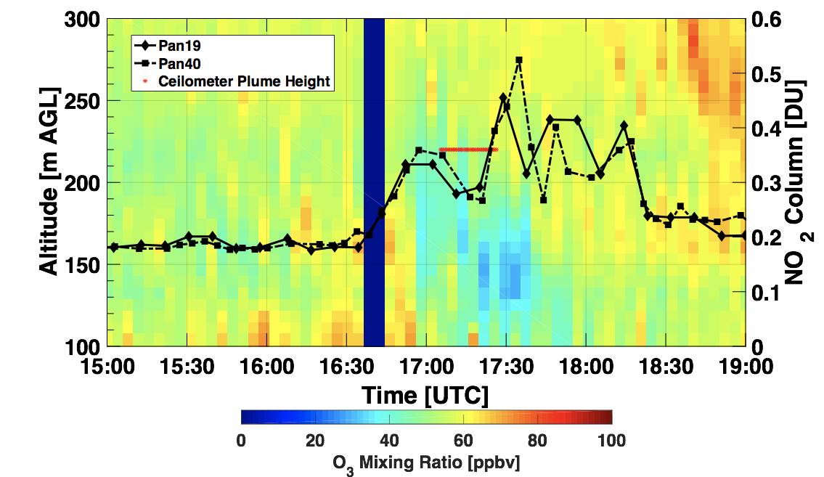
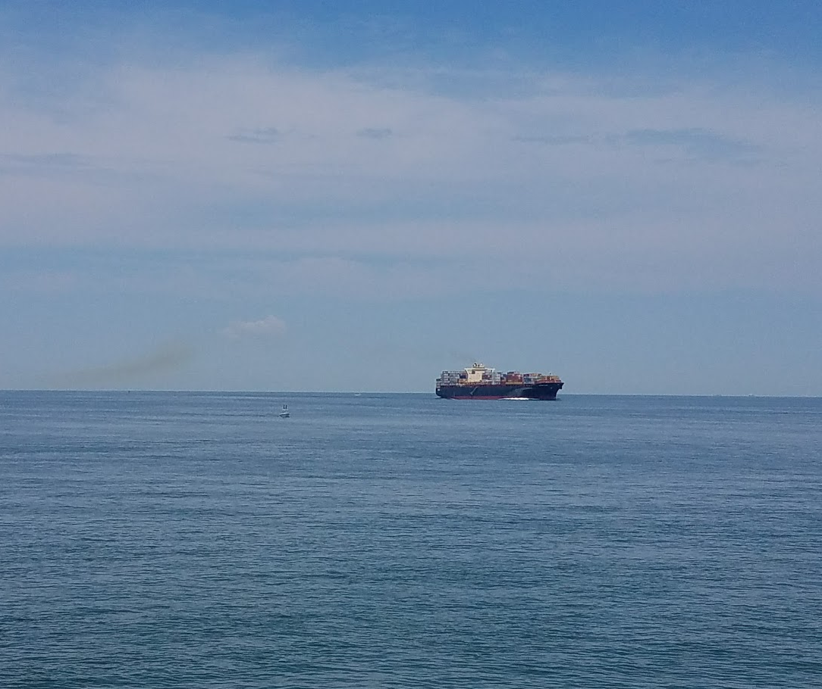
Interconversion/Titration Event
NO + O₃ ---> NO₂ + O₂
TOL, Pandora & Ceilometer, Aug. 1, 2017
*Credit to Lindsey R. F. Hendrick, VCU CES

Slide 13
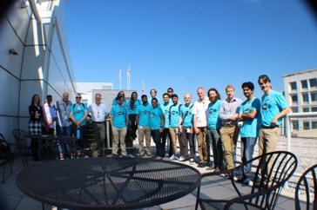
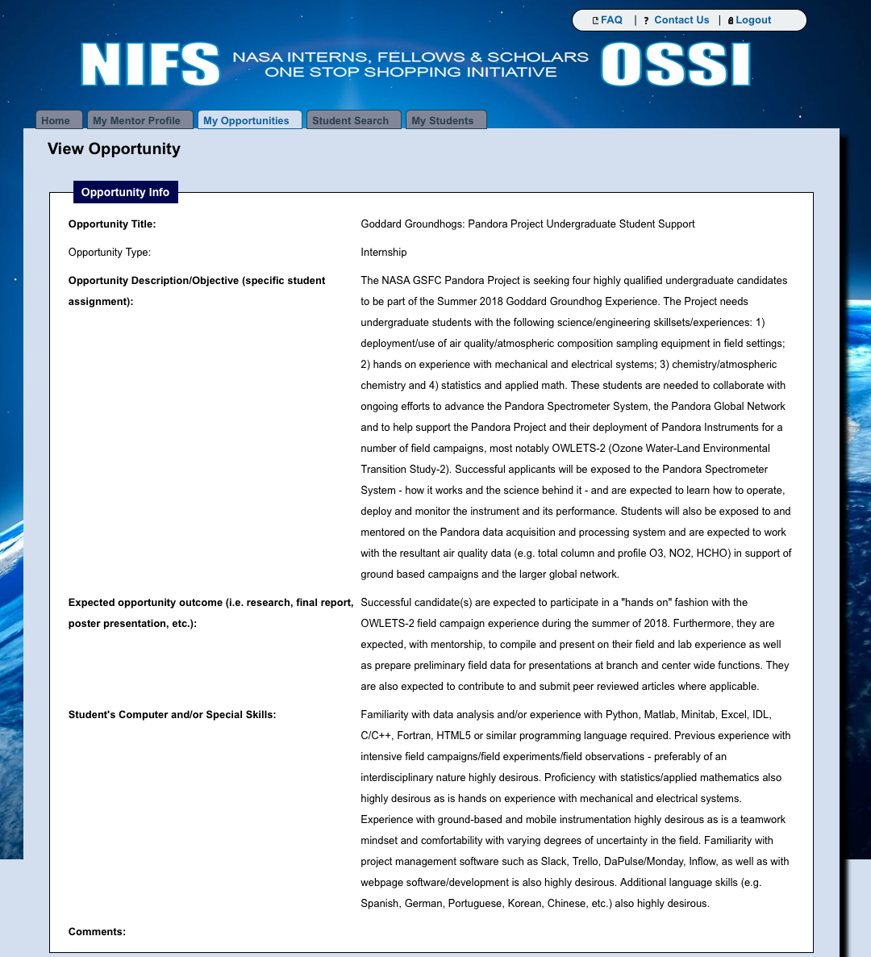
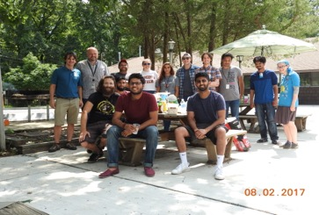
“Growing Our Own Timber”:
Grooming the Next Gen of ES Scientists

Slide 14
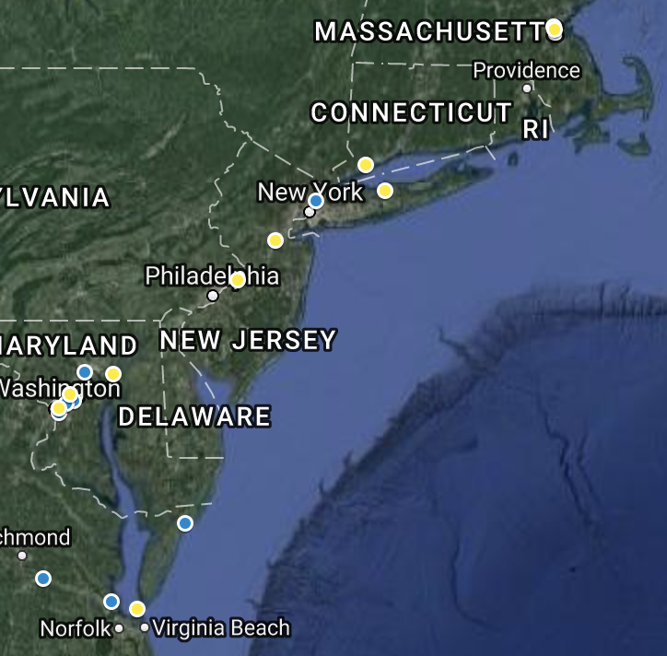
2018 Pandora Deployments in Northeastern U.S.
Yellow - to be deployed (11) + 2 mobile (boat)
Blue - currently sited (8)
Majority coincident w/ EPA PAM sites - for additional sites, see L. Valin poster
100 km

Slide 15
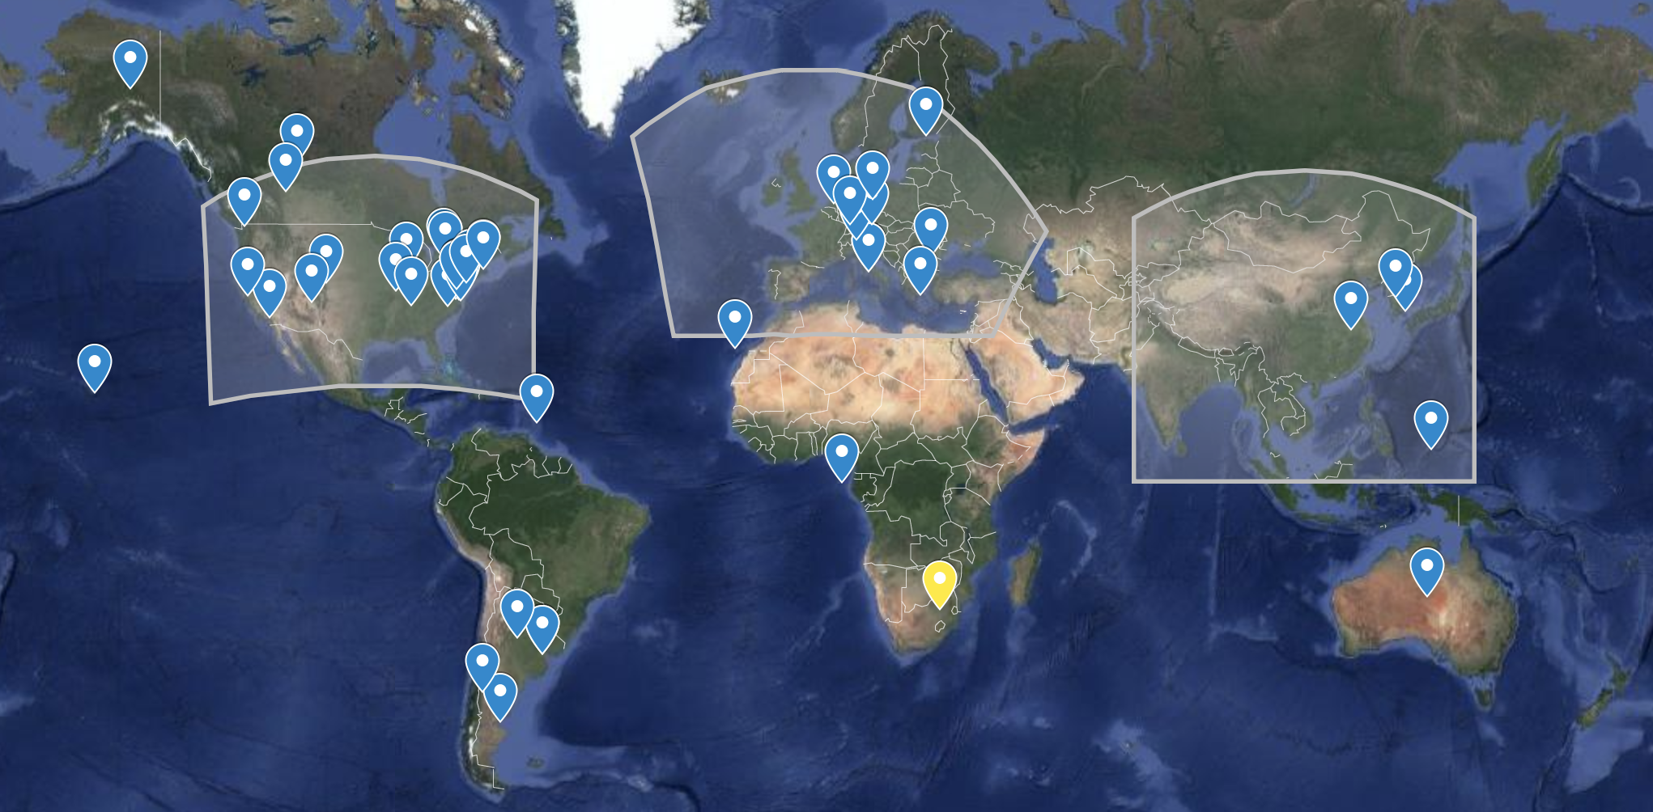
Current Configuration of PGN
GEMS
TEMPO
Sentinel-4
58 Instruments active globally with another 26 to be delivered in 2018
37 monitored by NASA GSFC Pandora, 21 by ESA-Pandonia
Possibility to provide hourly observations of O₃, NO₂, SO₂, HCHO from GEO is a major advancement for air quality (vs LEO 1x/day )
By year end min. 50 NASA owned instruments deployed and operational

Slide 16
Deployments this Spring
In support of EPA, MDE, OWLETS2, LISTOS
1 Instrument to NOAA ARL in College Park, MD (April)
1 Instrument to Hart Miller Island, MD (this am)
5 instruments to EPA in support of upcoming LISTOS to be sited in NE (installed this week)
1 Instrument back to SAO (this Friday)
1 Instrument to South Africa outside of Johannesburg (shipped this am)
Instruments to Be Delivered to TOLNET
5 instruments to TOLNET (delivery late June - hold up is trackers)
1 instrument to NASA Ames (delivery late June as well)
11 more Instruments to Be Delivered to Later this Year
Locations TBD but highly dependent upon ancillary measurements

Slide 17
Goals for this year
Establishment of international site / real property agreement templates where PGN Expectations are articulated in draft PGN Site Information Form to be released mid-June
Collaborative development of new operational algorithms and evaluation of existing ones
Maturing the remote monitoring and support of operations: instruments, local operators and scientists
Launch of collaborative PGN website (est. mid-July)
AGU Special Session (Observations and Modeling of Air Quality at Land-Water Boundaries, session ID#51995) with possible side meeting
Continued collaboration w TOLNET, AERONET, MPLNET
Science Workshop on Pandora - TBD - possibly in conjunction w AGU
Continued expansion of the NASA Pandora, leveraging ancillary observations at local, state and fed DEQ/EPA AQ monitoring sites

Slide 18
Thank you.
For more information please contact:
robert.j.swap@nasa.gov

